Slide 1

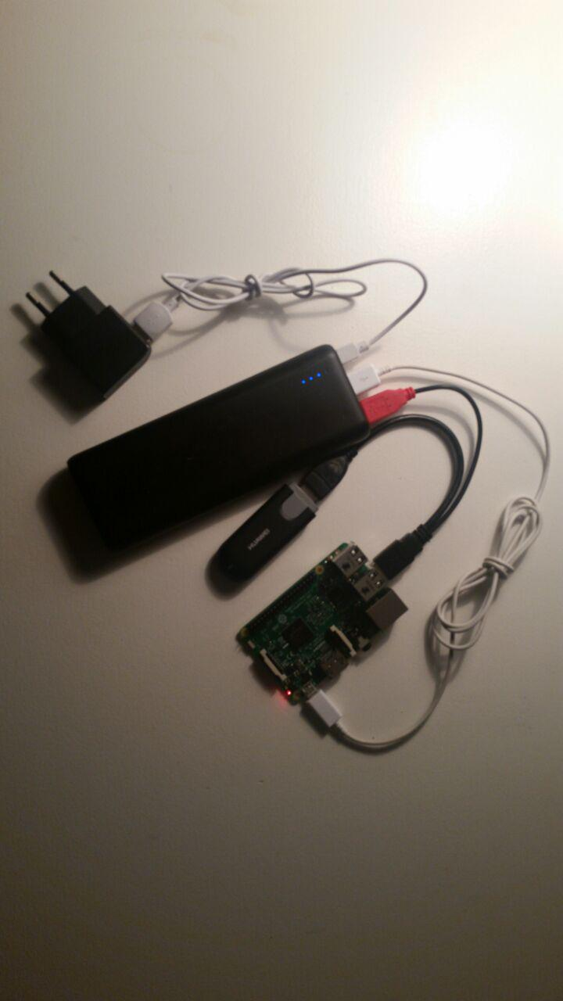
Built by Niels ten Oever & Shane Kerr
Wired connectivity managed by Alexander Blom
an ISOC NL project

Slide 2
Refugee Hotspot

Slide 3






Organizations
Organizer and Initiator
Sponsor
License
Collaborators
Contributors

Slide 4

Migrants & Refugees
Definitions, definitions, definitions
UN convention on Status of Refugees
UN protocol relating to the Status of Refugees
EU Charter of Fundamental Rights
Dublin Agreement
State of Exception
People in Limbo
Sans Papiers

Slide 5

Situation in the Netherlands
Refugees centrally registered by Centraal Orgaan opvang Asielzoekers (COA)
It's COA policy to provide Internet access at its centers
COA is overwhelmed with large influx
COA doesn't provide services to undocumented migrants

Slide 6

Objective
Providing Internet access to migrant and refugees – those who need it most
Activities
Provide wired Internet access in (semi-)permanent locations
Provide wireless access in all other situations

Slide 7
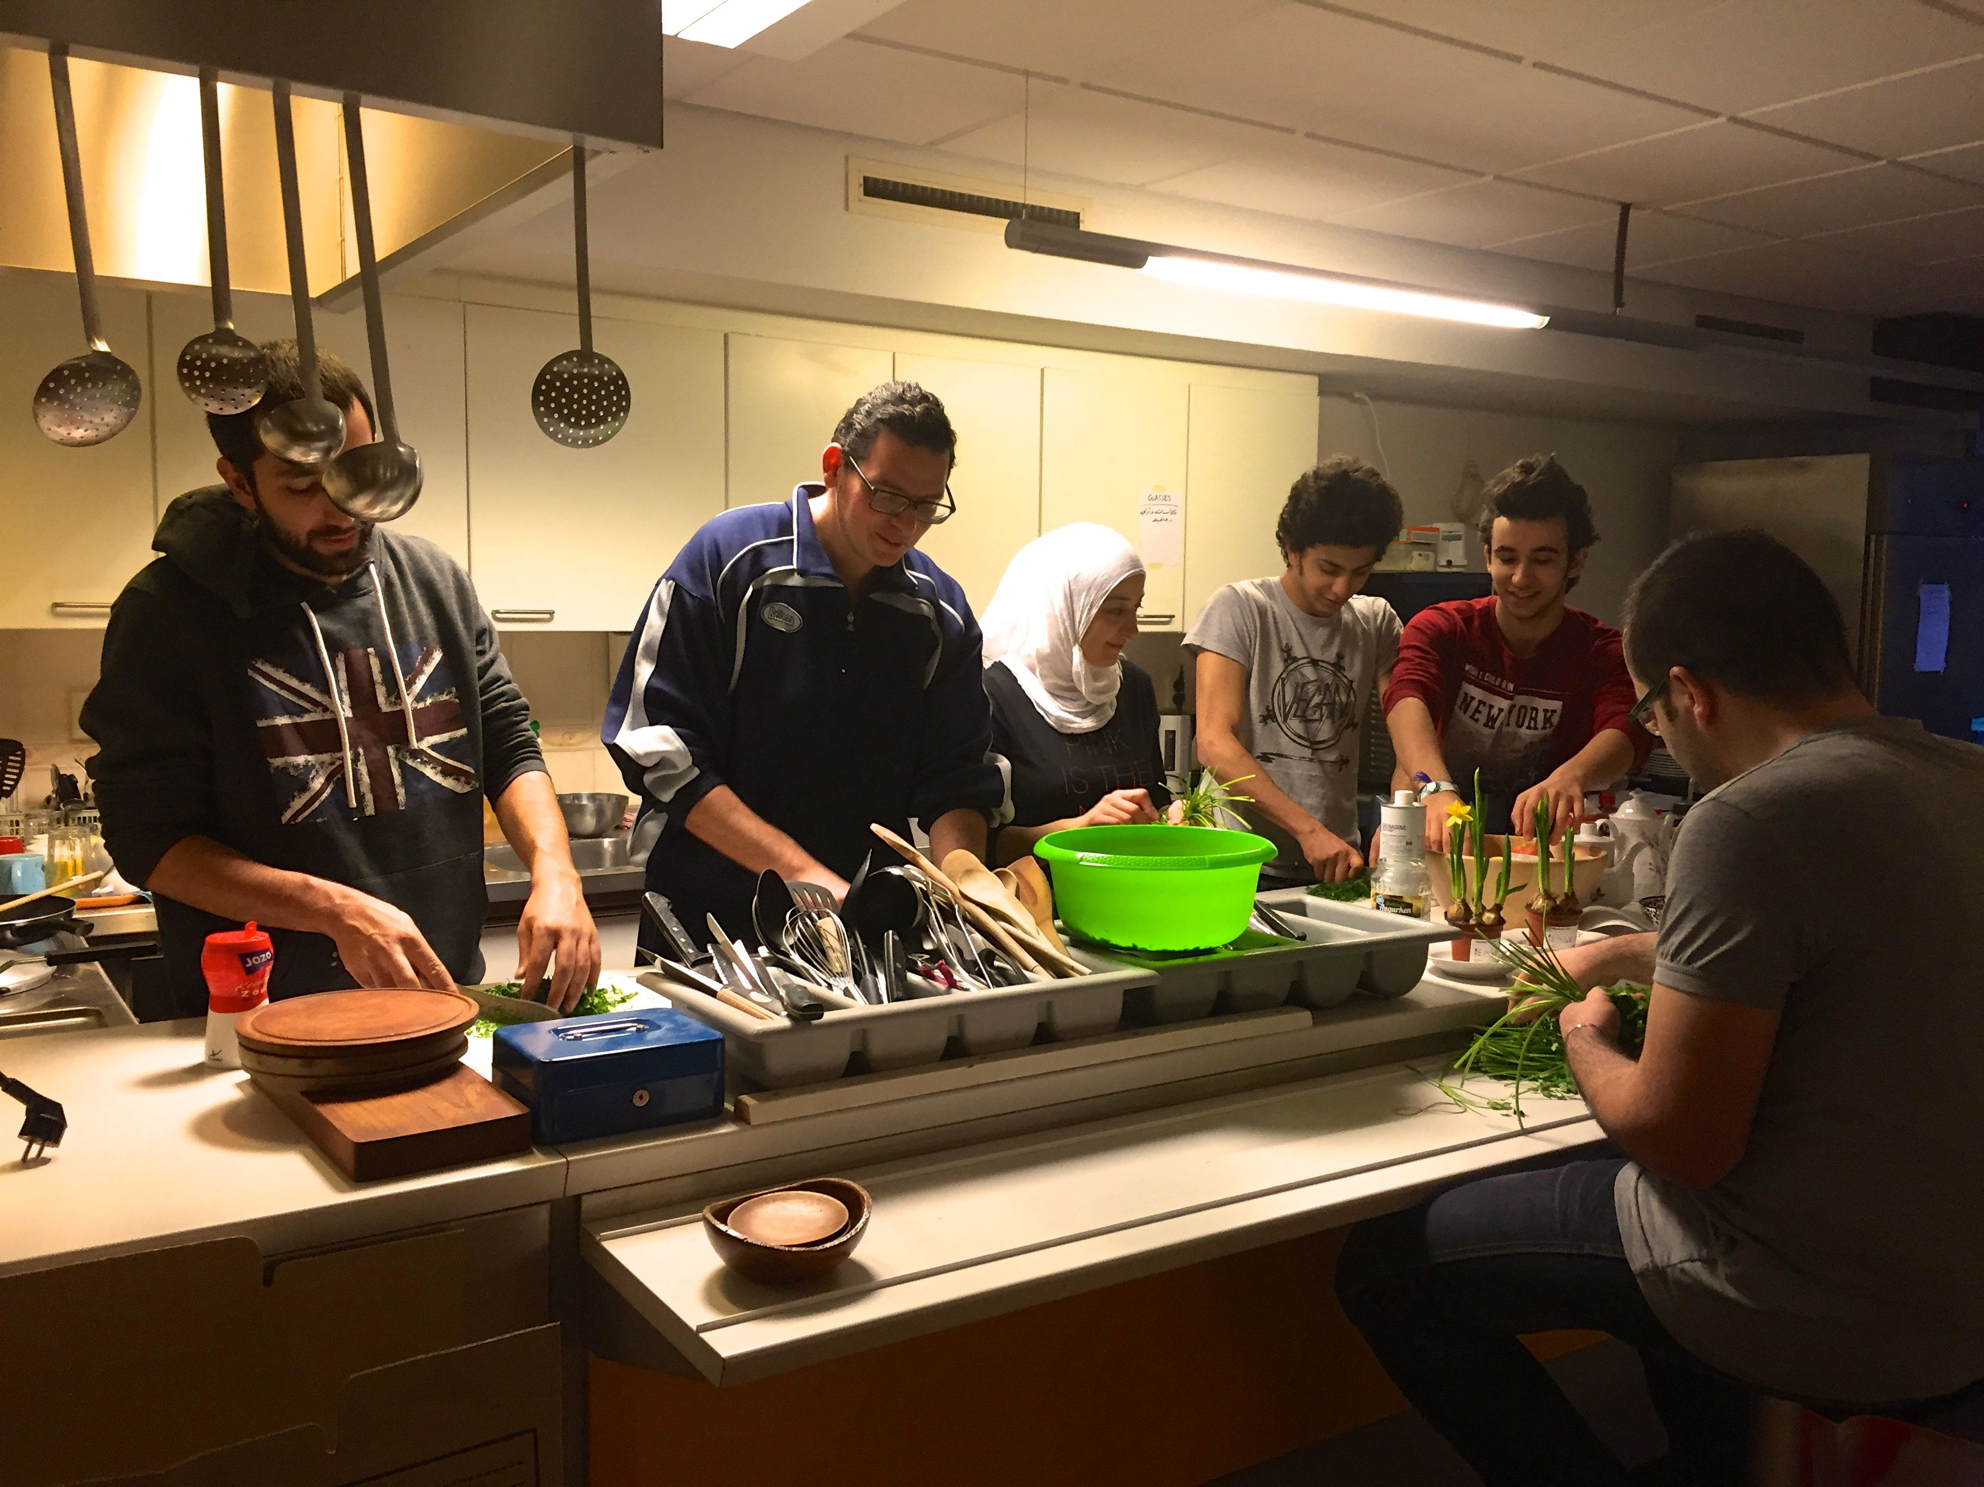

Two centers connected

Slide 8
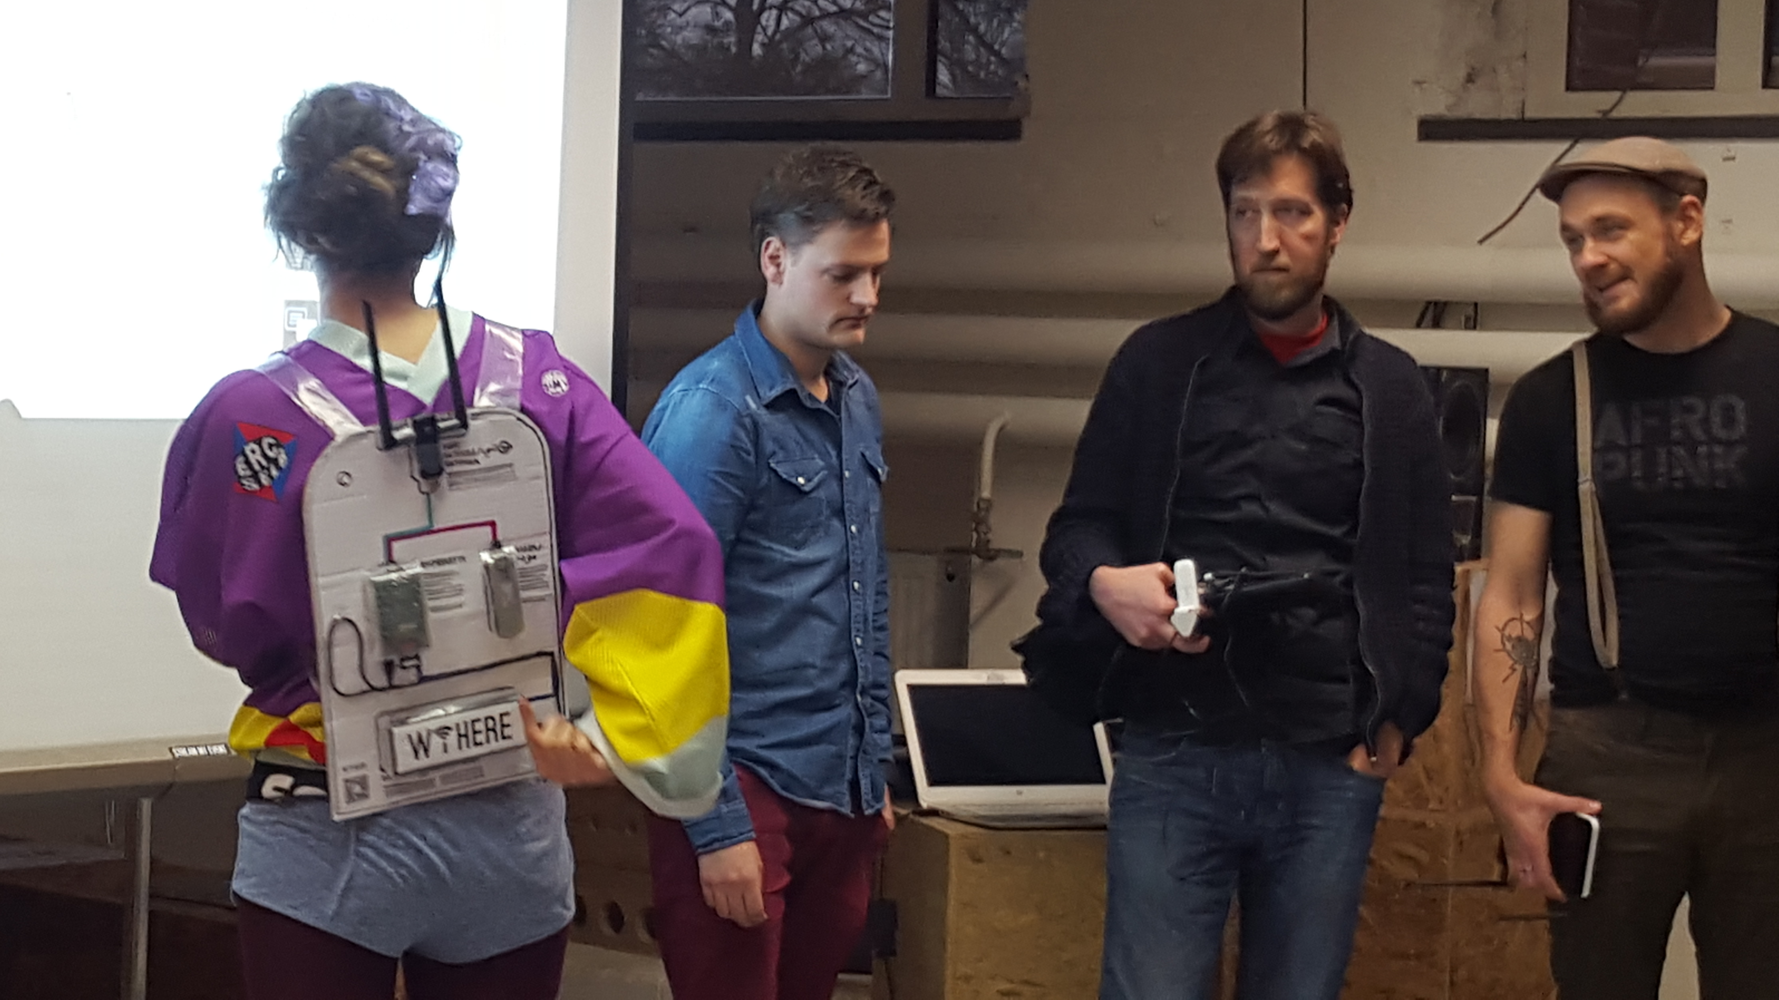
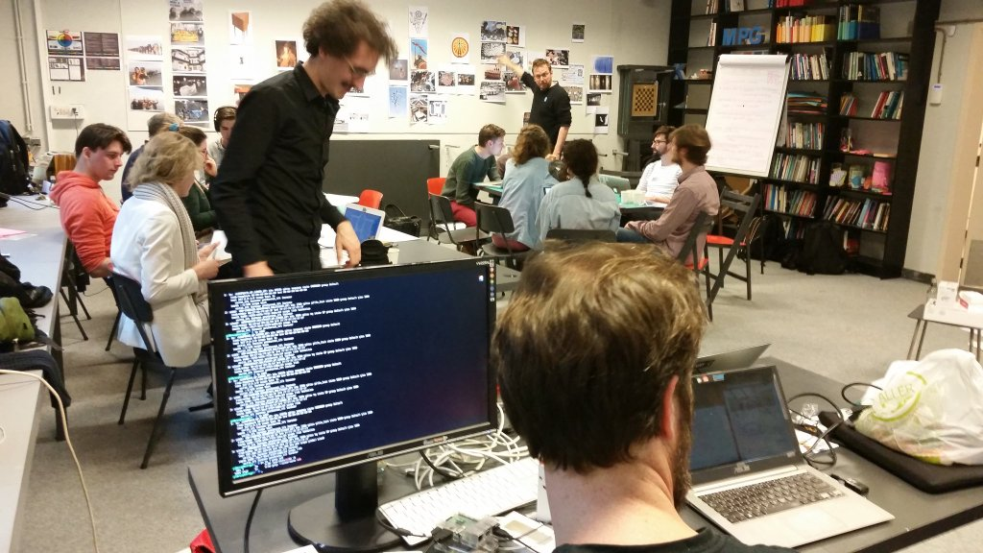
Hackathon!

Slide 9
Requirements
Portable and sturdy (eviction or demonstration)
Minimal state (privacy)
Shareable bandwith
Reasonable security expectations
Landingpage // information page
Remote administation
Reasonably priced
                ┻━┻︵ \(°□°)/ ︵ ┻━┻

Slide 10
Prelimenary findings
No existing cheap hardware that can do rate limiting + landingpage
Netaidkit has nice security features but too low specs
OpenWRT seems like a bit of a pain
Raspberry Pi is very versatile and runs Debian
( ͡° ͜ʖ ͡°)﻿

Slide 11
Intermediary findings
It takes longer than expected :P
3G dongles need voodoo drivers
3G dongles need an external power source
Raspberry Pi 3 comes out with integrated WiFi antenna!
¯\_(ツ)_/¯

Slide 12
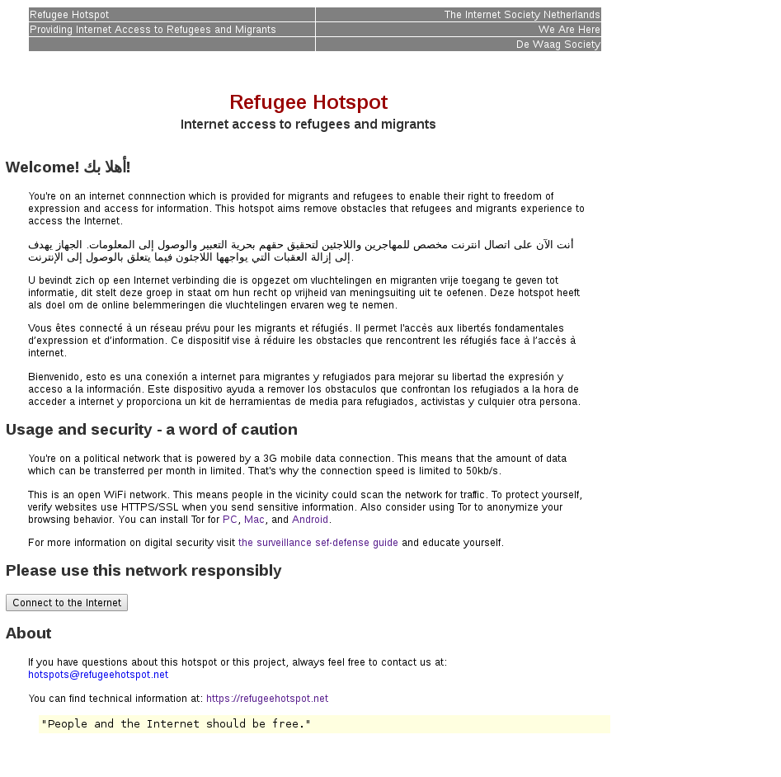

Slide 13
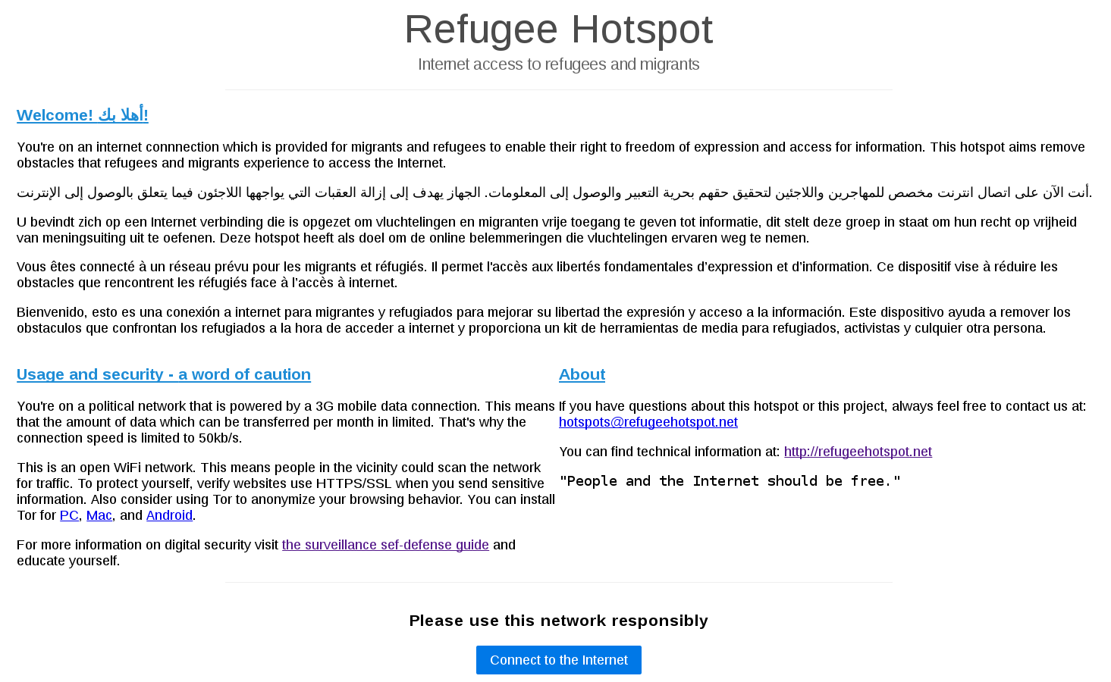

Slide 14


Slide 15

Future?
Smooth install script
Beta testing with 'We Are Here'-collective
Casing with De Waag Society
Dissemination and larger scale testing with collectives in Hamburg, Berlin, and Brussels
Dissemination throughout Europe and beyond

Slide 16
Contribute?
Manual designers
Beta testers
Ideas (for instance GSM -> UTP failover)
PULL REQUESTS ┗(-_-﻿ )┓┗(-_-)┛┏(-_-)┓

Slide 17


